Slide 2
One API to Rule Them All?
Keith Mattix, Microsoft
John Howard, Google

Slide 3
The Beginning
2015: Kubernetes is launched
Has some traditional "service mesh features"
2017: Linkerd2 and Istio launched, bringing more extensive feature sets
HTTP/gRPC load balancing and routing
mTLS
Telemetry and tracing
Over the years, more and more service mesh implementations offer their own feature set and custom API
Notes:
John

Slide 4
kind: VirtualService
spec:
hosts:
- reviews
http:
- match:
- uri:
prefix: "/frontpage"
route:
- destination:
host: frontpage
apiVersion: v1alpha2
kind: ServiceProfile
spec:
routes:
- name: '/books'
condition:
method: POST
pathRegex: '/books'
- name: '/books/{id}'
condition:
method: GET
pathRegex: '/books/\d+'
apiVersion: v1alpha1
kind: TrafficRoute
mesh: default
metadata:
name: route-all-default
spec:
sources:
- match:
kuma.io/service: '*'
destinations:
- match:
kuma.io/service: '*'
apiVersion: v1beta2
kind: VirtualRouter
spec:
listeners:
- portMapping:
port: 80
protocol: http
routes:
- name: my-service-a-route
httpRoute:
match:
prefix: /
apiVersion: v1alpha1
kind: ServiceRouter
metadata:
name: web
spec:
routes:
- match:
http:
pathPrefix: /admin
destination:
service: admin
Notes:
John

Slide 5
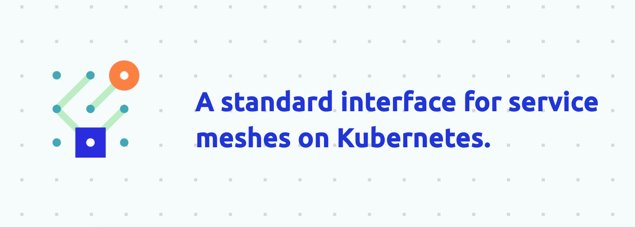
A Unified Standard
Notes:
Keith

Slide 6
A Unified Standard
kind: TrafficSplit
metadata:
name: ab-test
spec:
service: website
matches:
- kind: HTTPRouteGroup
name: ab-test
backends:
- service: website-v1
weight: 0
- service: website-v2
weight: 100
kind: HTTPRouteGroup
metadata:
name: ab-test
matches:
- name: firefox-users
headers:
user-agent: ".*Firefox.*"
Notes:
Keith

Slide 7
A Unified Standard?
Initial design decisions were incongruent with where community went
Binding authorization policy solely to routes, no concept of a workload, etc.
Traffic metrics was pre-OpenTelemetry
Key maintainers moved to other projects
No resources advanced from alpha
Notes:
Keith

Slide 8
A Tale of Two Specs
Over in Kubernetes world, the same kind of thing started to happen
Ingress APIs were the common interface for the plethora of ingress controllers on the market
Ingress struggled to grow with the community
Non-portable features/extensions
Annotation proliferation
Required lengthy, involved KEP process to iterate
Notes:
John

Slide 9
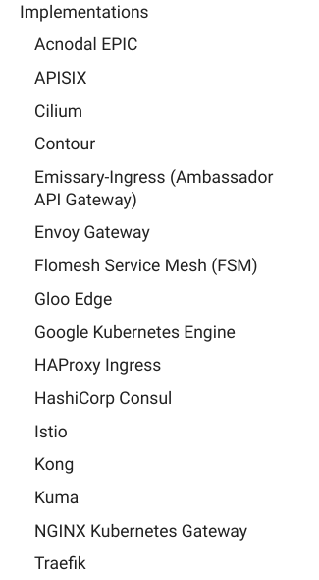
Gateway API
Gateway API introduced by Kubernetes to build a unified service networking model for Kubernetes.
Learns from the mistakes of Ingress and vendor APIs to build a new API that is extensible.
API recently graduated to Beta, with over 15 implementations.
Notes:
John

Slide 10
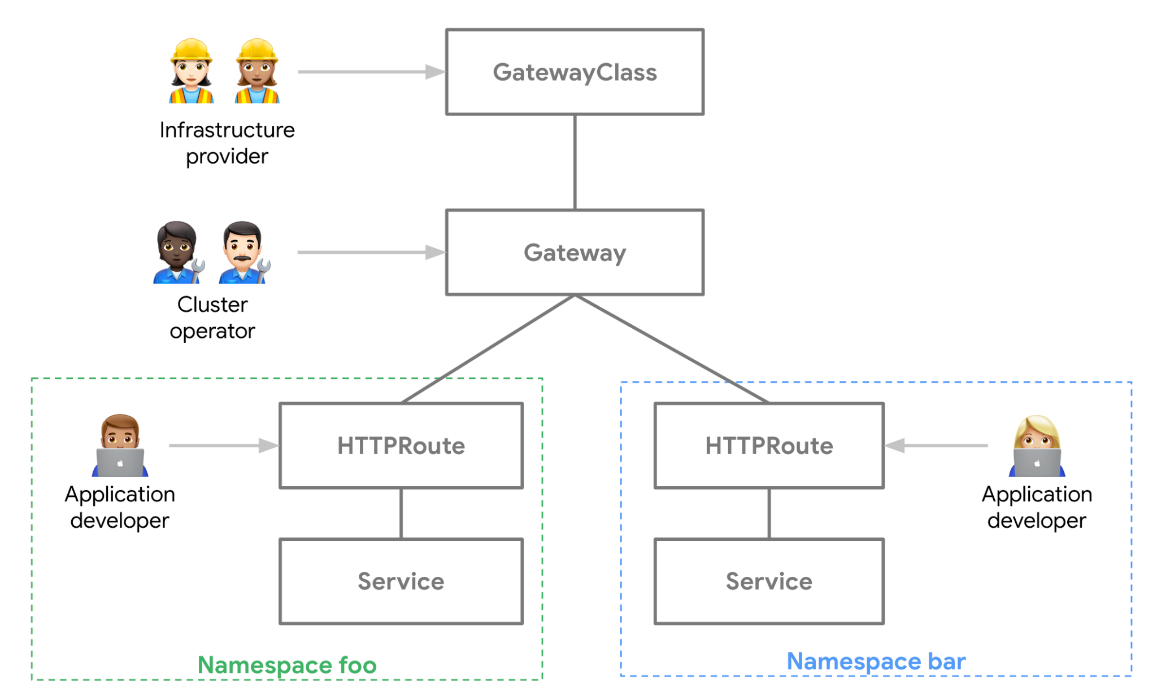
Gateway API
Notes:
John

Slide 11
Gateway API
kind: HTTPRoute
metadata:
name: my-route
spec:
parentRefs:
- kind: Gateway
name: foo-gateway
rules:
- backendRefs:
- name: foo-svc
port: 8080
kind: Gateway
metadata:
name: foo-gateway
spec:
gatewayClassName: foo-lb
listeners:
- name: prod-web
port: 80
protocol: HTTP
Notes:
John

Slide 12
One API to Rule them All?
The features present in the spec are by no means specific to ingress traffic; in fact, just about every project represented here exposes near identical functionality to their users. Therefore…the greater cloud-native community would greatly benefit from Gateway API being a universal set of resources to describe all Kubernetes traffic, north/south and east/west.
Notes:
Keith

Slide 13
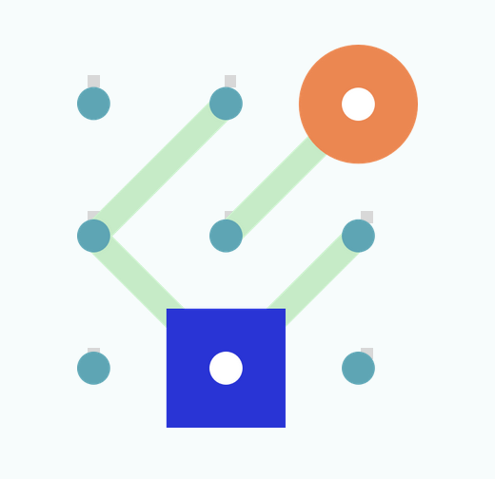

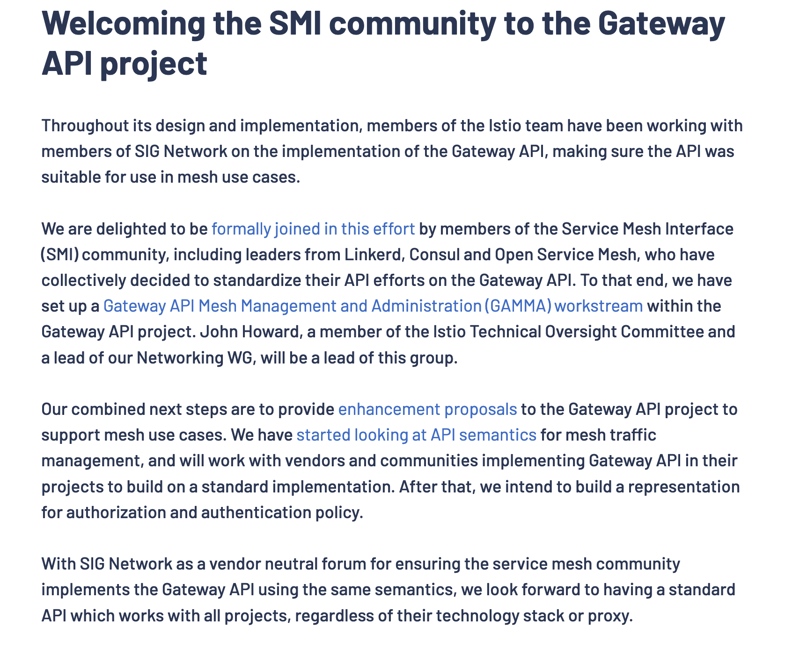
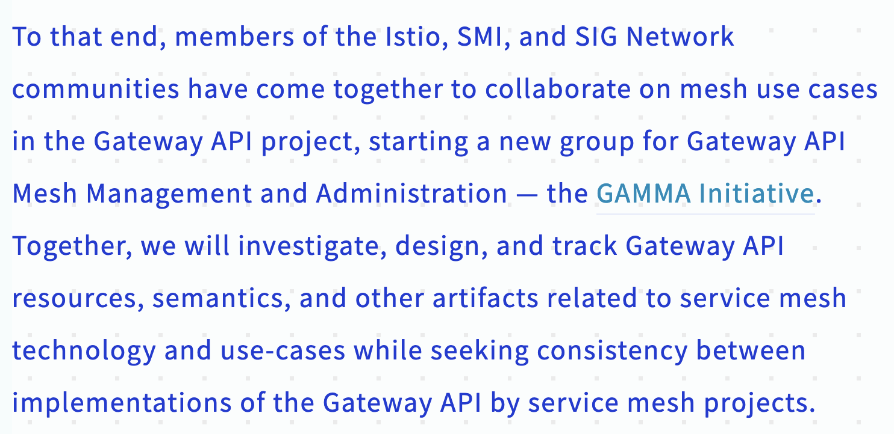
One API to Rule them All?
Notes:
Keith

Slide 14
The GAMMA Initiative
GAMMA (Gateway API for Mesh Management and Administration) initiative was started to bring the benefits of Gateway API to service mesh
Separate workstream within sig-network/Gateway API subproject
A unified API across vendors for Ingress and service mesh
First meeting on July 26th 2022
Weekly Tuesday meetings ever since
Notes:
Keith

Slide 15


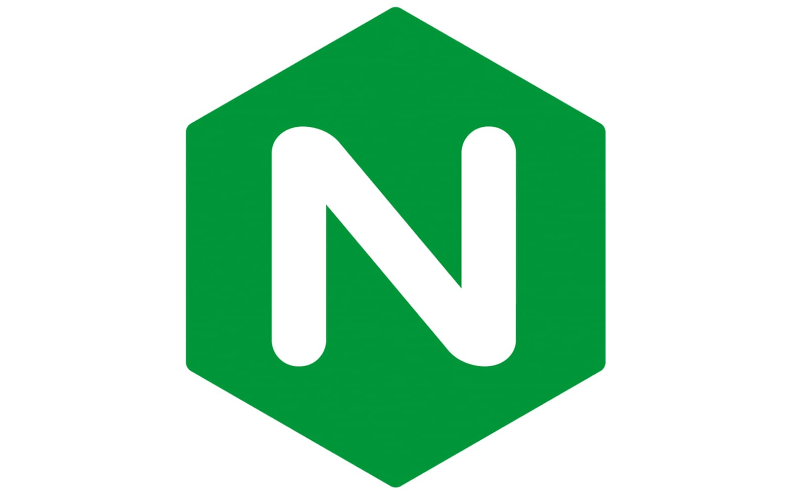






Where are we now?
Notes:
John

Slide 16
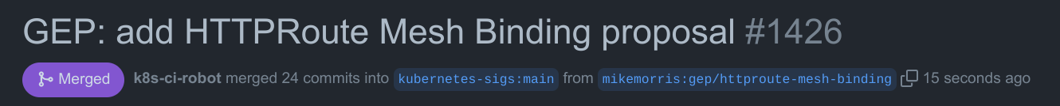
Where are we now?
Notes:
John

Slide 17
Where are we now?
apiVersion: gateway.k8s.io/v1beta1
kind: HTTPRoute
metadata:
name: foo
spec:
parentRefs:
- kind: Service
name: foo
rules:
backendRefs:
- kind: Service
name: foo
weight: 90
- kind: Service
name: foo-v2
weight: 10
Notes:
John

Slide 18



Where are we going?
Authorization Policy
Egress
Workload policy attachment
Notes:
Keith

Slide 19
Get involved
Resources:
How to Get Involved - Kubernetes Gateway API
GAMMA - Kubernetes Gateway API
https://github.com/kubernetes-sigs/gateway-api
Get involved:
Weekly meetings
Review PRs and GEPs
Try it out and give feedback!
#sig-network-gateway-api on Slack
Notes:
Keith

Slide 20
Thank you!

Slide 21

Session QR Codes will be sent via email before the event
Please scan the QR Code above to leave feedback on this session

